Slide 1
Business Architecture Aligns POV across an organization and between organizations (verticals & horizontals)
WHY
WHAT
Customer Perspective
What a Customer Wants
Strategic Perspective
Customer Perspective
Internal Stakeholder
(X-Functional) Perspective
What an Organization Provides
Investment & Solution
Perspective
Customer Needs
Compliance Needs
Desired Outcomes
Strategy
Value Stream
Initiative
Business
Stakeholder Needs
Value Stream Stage
Capability
Operations Perspective
BU & LOB Perspective
Value (Capability) Gap Perspective
Requirement
Business Entity
Internal
Stakeholder
Product & Service Support
Execution Delivery Perspective
Product & Service Delivery
Product & Service Portfolio
Solution Delivery
Solution Architecture
HOW
Requirements are framed by the strategy they implement, seen through stakeholder value perspective (value stream) and what the business has the ability to do to deliver that value (capability)
Requirements are additionally bound by investment, project and stakeholder focus
Other perspectives for framing, such as product and service, may be exposed using business architecture

Slide 2
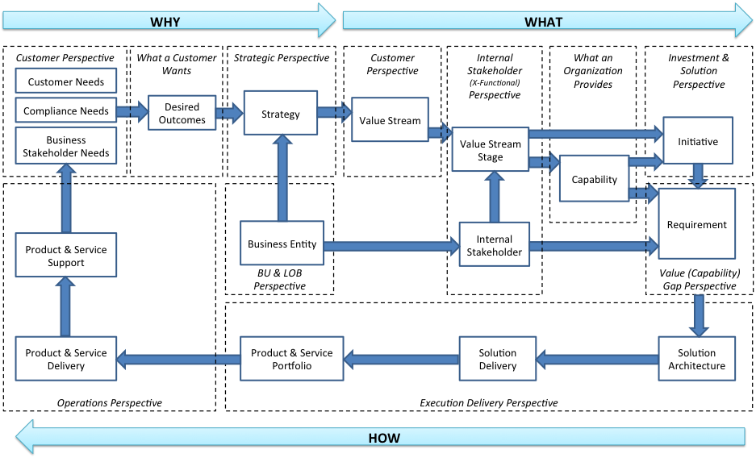
Business Architecture Aligns POV across an organization and between organizations (verticals & horizontals)
The Value Stream Stages embody the separation of concerns within the organization for aligning capabilities, resources, and assets to meet the needs for external & internal stakeholders per each value stream
The Value Stream embodies what we need to deliver to address stakeholder needs
What a customer wants (not asks)
The Internal Stakeholders will shape the capabilities (beyond level 1) in the Value Stream Stages (via their resources, assets, & processes)
Business Entities will shape the Strategy
(this is where business innovation typically occurs)
Requirements are framed by the strategy they implement, seen through stakeholder value perspective (value stream) and what the business has the ability to do to deliver that value (capability)
Requirements are additionally bound by investment, project and stakeholder focus
Other perspectives for framing, such as product and service, may be exposed using business architecture

Slide 3
Initiatives
Programs
Projects
Activities
Tasks
Desired Outcomes
Customers
Compliance
Stakeholders
Planning
Decisions
Operational Portfolios for delivering Value Streams
Value
Business Processes
Capabilities
Priorities
Goals & Objectives
Functional Plans
Operational Plans
Dept. / Div. Plans
LOB Plans
Organization Plans
Organizational & 3rd Party Portfolios of Assets
Products
Services
Risks
Gap Assessment
(Needs vs. Capabilities)
Human Assets
Un-Planned Outcomes
Information
Physical Assets
Logical Assets
Financial Assets
Value Gap Assessment
Value Gap Closure
Value Delivery
Measures
Monitoring, Instrumentation
Metrics, KPIs & Alerts
Analytics & Reports
Value Measurement

